Slide 1
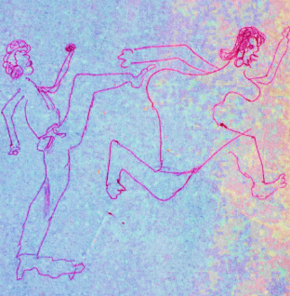
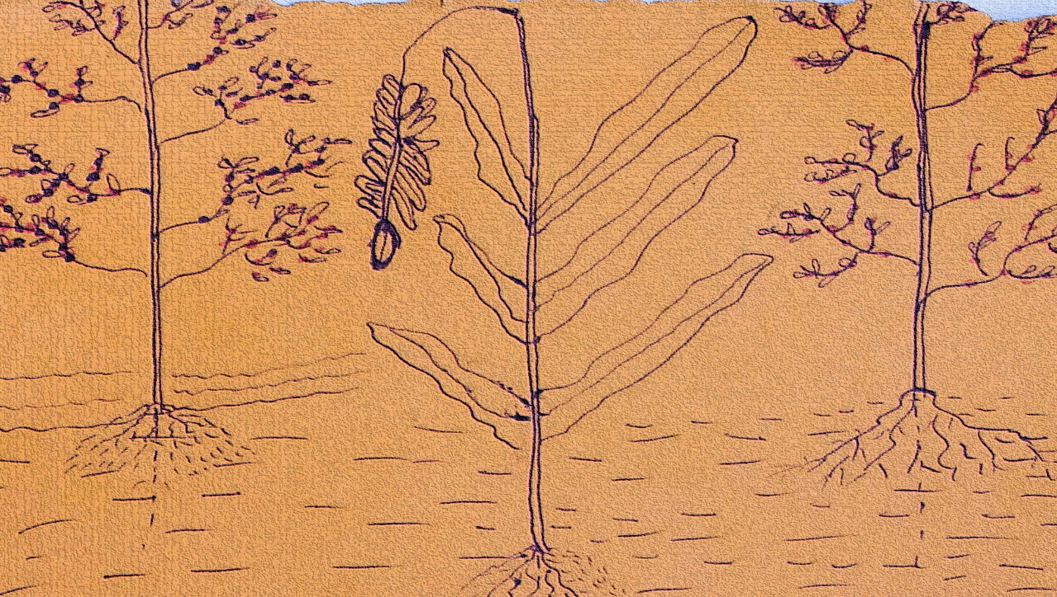
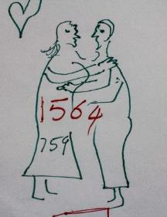
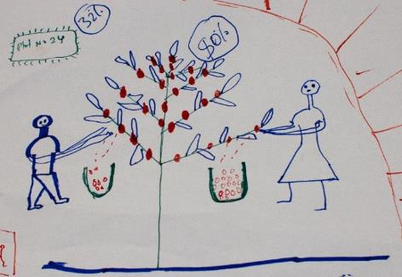
Happy Family Happy Coffee
Empowering Women, Youth and Men Farmers
To Sustainably Implement
Good Agricultural Practices in Coffee Sector
Linda Mayoux,
Intan Dharmawati
Mashadi Mulyo
Catherine van der Wees

Slide 2
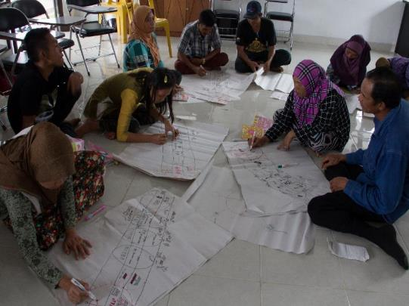
‘Happy Family Happy Coffee’ is:
A training methodology that:
uses the diagram tools and participatory facilitation techniques of Gender Action Learning for Sustainability (GALS) methodology to:
empower women and youth coffee farmers to implement and fully benefit from Good Agricultural Practices (GAPS) in Coffee
improve relationships and trust between coffee farmers, companies, traders and service providers – leading to happy staff and happy companies.

Slide 3
Integrated GALS/GAPS Curriculum

Slide 4
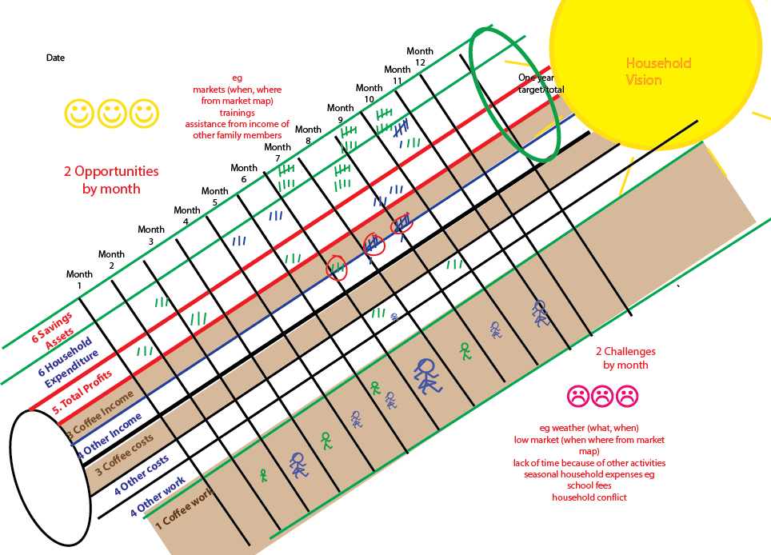
Coffee Vision Calendar Framework

Slide 5
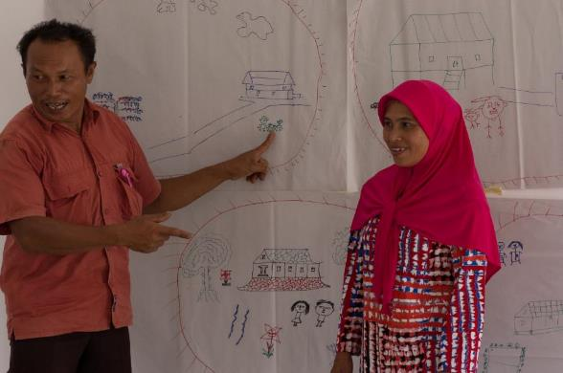
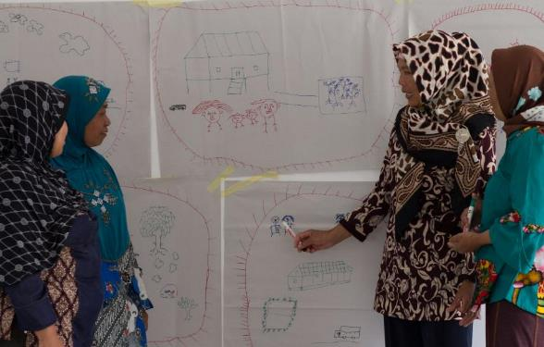
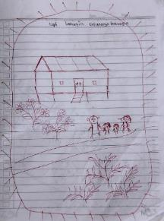
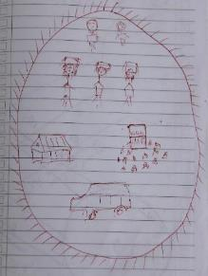
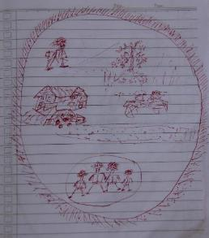
1: Vision
places coffee in the context of a wider vision for happiness and success in the family and community increases commitment to good quality coffee.
introduces discussion of what is meant by coffee quality, environmental issues and relationships in the household.

Slide 6
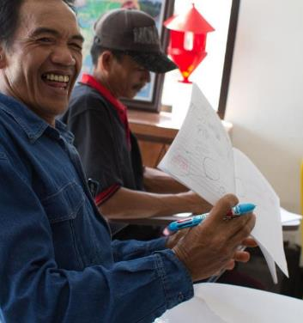
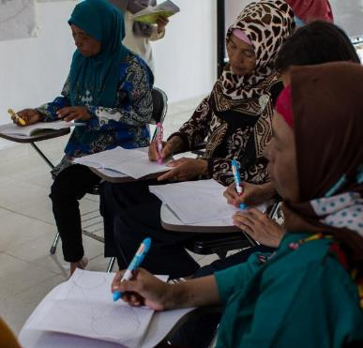
2: Vision Journey
^{teaches basic planning skills}
places coffee even more firmly as a significant contribution to family development towards a vision.

Slide 7
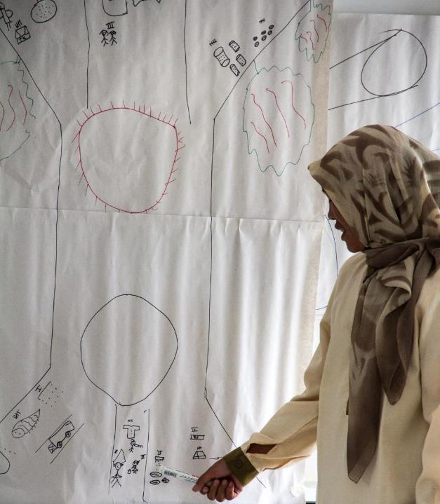
3: Increasing Coffee Incomes Challenge Action Tree
looks at the production (GAPs and environmental), marketing (including relationships with companies) and household (gender, youth, child labour, health and safety to increasing farmer incomes from coffee.
asks farmers to identify what they see as solutions that they can implement themselves and make 10 change commitments.
This enables companies to assess what farmers already know and can share with each other. This enables service providers to see where they need to add and/or correct information to make technical trainings much more cost-effective and focussed on what farmers really need to know.
The same Challenge Action Tree tool is then used to frame each practical technical GAPs session to look in more detail at e.g. canopy management etc.

Slide 8
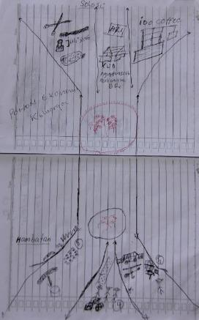
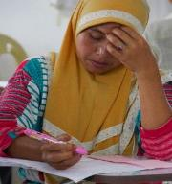
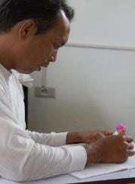
Individual Trees and monitoring

Slide 9
4: Happy Family Tree
looks in more detail at the middle household part of the Increasing Coffee Incomes Challenge Action Tree to analyse:
how division of labour within the household can be made more equitable and efficient
how expenditure can better reward those doing the work.
how more equal ownership and decision-making can make households happier and more efficient.
Identifies at least 10 change commitments for moving forward.
This leads to increased cooperation and transparency in the household and reduction in wasteful expenditures, reducing for example the need for side selling of coffee to middlemen.

Slide 10
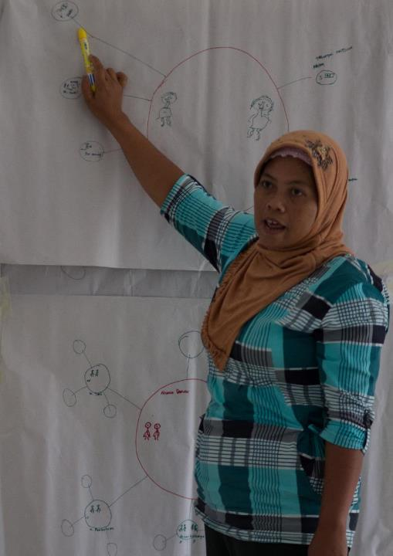
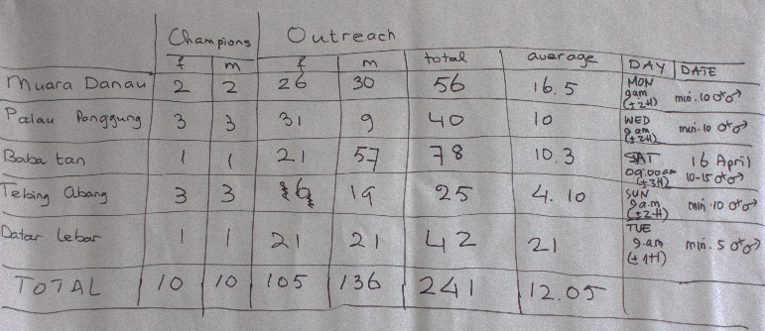
5: Change Leadership Map
identifies existing social networks through which GALS/GAPs messages can be delivered on a voluntary basis to disseminate planning skills, gender messages and technical information. This makes the job of company staff and promoter farmers easier.

Slide 11
6: Multilane Household Vision Plan
Brings together outputs from other tools onto one change plan
Top Lane production (from Vision Journey and Challenge Action Tree Production and Marketing)
Middle Lane Household Relationships (from Vision, Challenge Action Tree Household and Household Efficiency Tree)
Bottom Lane Peer sharing/leadership (from Change Leadership Map)
This is then the main monitoring tool for tracking and monitoring.

Slide 12
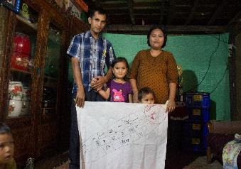
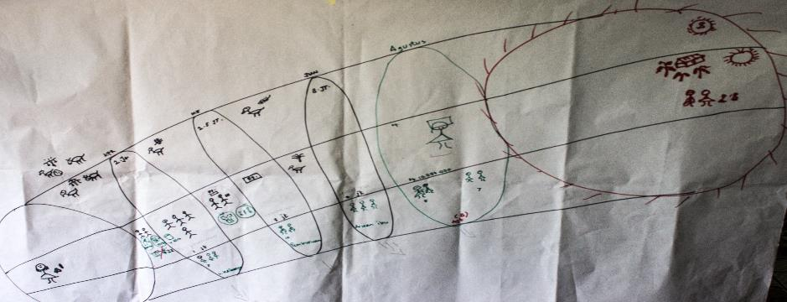
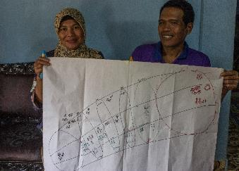
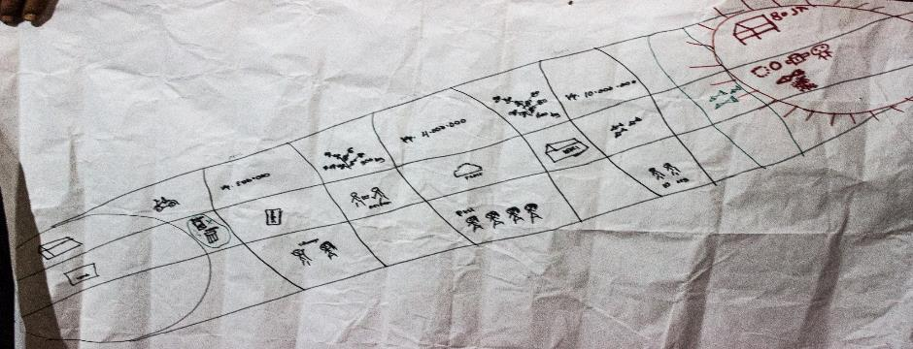
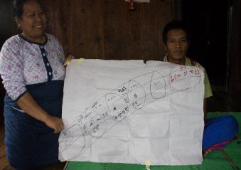

Slide 13
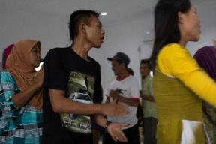
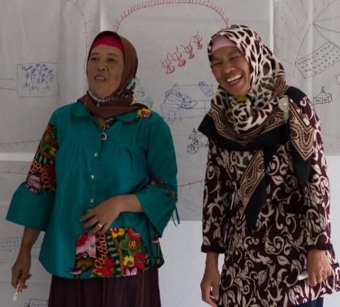
Ingredients for success
FUN!!
Inspiration, not policing
Partnership and ownership, not control
Focus on action can change, not too much detailed analysis
Champion facilitation skills
Supportive follow-up
Responding to real needs that come up
Women and youth rights constantly reinforced

Slide 14
Roles of champions and staff
FARMER CHAMPIONS
Implement their own development and change plans together with their families
Track their own progress on their diagrams, particularly multilane highway – green fruits turn red
Scale up GALS in their own families, social networks and communities
After 6 months to one year the best voluntary champions are certified to be paid trainers for replication in other communities
ICC STAFF
Train on GAPS but integrate GALS facilitation techniques and reinforcement on gender and youth messages
Validate and support on progressive development of information on diagrams
Staff identify champions to be certified as paid trainers to replicate
Aggregation of information on farmer changes and upscaling
Development of business case for gender and youth empowerment and GALS
Communicating progress to the company

Slide 15
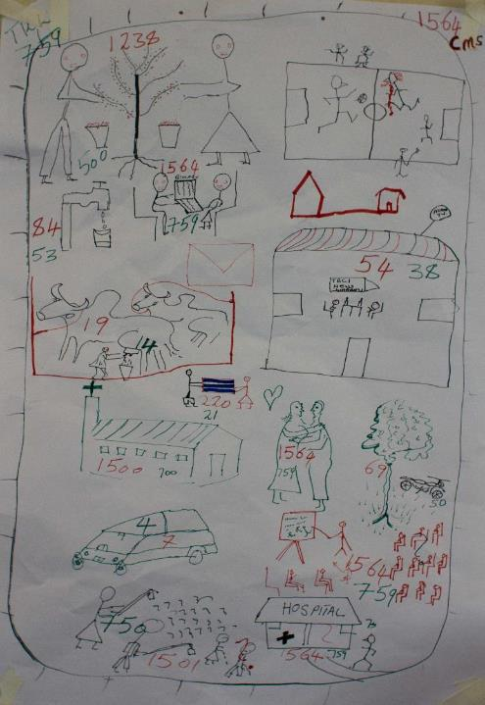
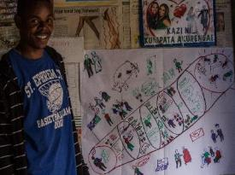
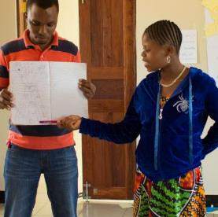
Following Years
More in-depth work on gender through other more advanced GALS Tools
Business Training using GALS Livelihood Tools or existing business training materials
Leadership and governance training using GALS Leadership Tools or existing training materials

Slide 16
This workshop
Shared IndoCafCo vision for Happy Family Happy Coffee
Sharing of the main GALS Tools for Happy Family Happy Coffee and adaptations for Indonesia context
Sharing of GALS facilitation principles and techniques and adaptations for Indonesia context
Discussion of whether and how some GALS tools and/or facilitation techniques might also be useful for GAPS
Clarification of role of ICC staff in implementation
Agreement on initial indicators, monitoring process and roles of farmers, IndoCafCo staff and management, and Hivos
Agreement on upscaling process and roles of farmers, IndoCafCo staff and management, and Hivos
Begin design of HFHC calendar and process for Semendo Phase 2
Anything else needed by staff

